Slide 1
MULTIPAGE RESPONSIVE WEBSTE
PPT PRESENTATION ON
BY
M.S.L.BHAVANI
S.NAGA GEETHA
V.S.N.KALYANI

Slide 2
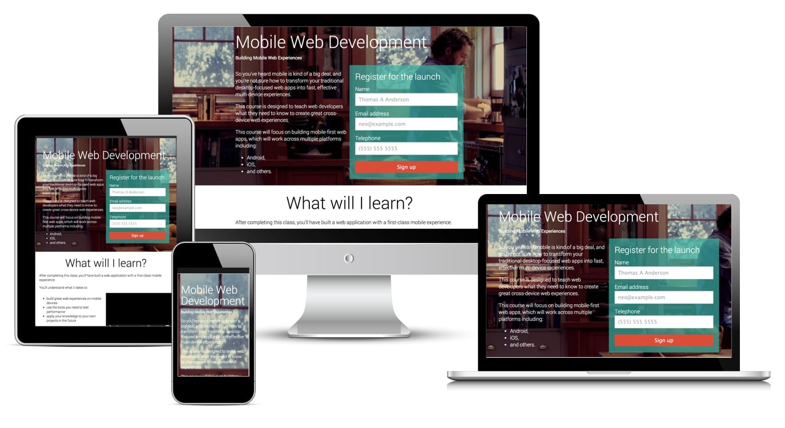
responsive websites respond to their environment.

Slide 3
Responsive website can be achieved through
these short features:
The site must be built with a flexible grid foundation.
Images that are incorporated in to design must be flexible themselves.
Different views must be enabled in different contexts via media queries.

Slide 4
Responsive design also has some distinctive features that make everything work smoothly on your website and make it suitable for any device. They are:
Fluid grids
Flexible visuals
Media queries

Slide 5
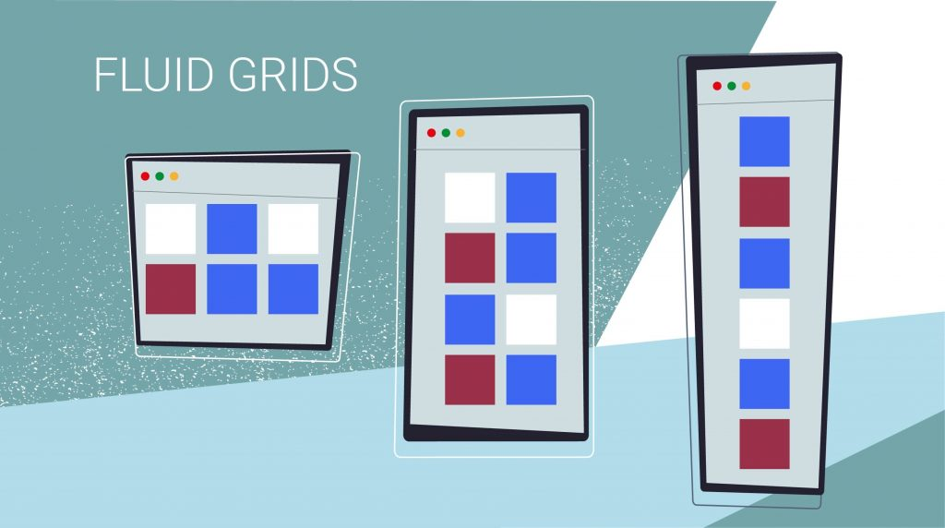
Fluid grids
Modern users tend to use their mobile devices more and more. But at the same time, their desktop screens become wider. For this reason, it’s impossible to focus the design only on smart phone screens or PC ones – it must look flawless at any resolution. Regardless of what device screen the user has, the flexible grid elements will adapt to the user’s environment. The trick is that it uses CSS and percentage. The percentage-based calculations are what make everything work and there’s no need to give up complexity for flexibility

Slide 6
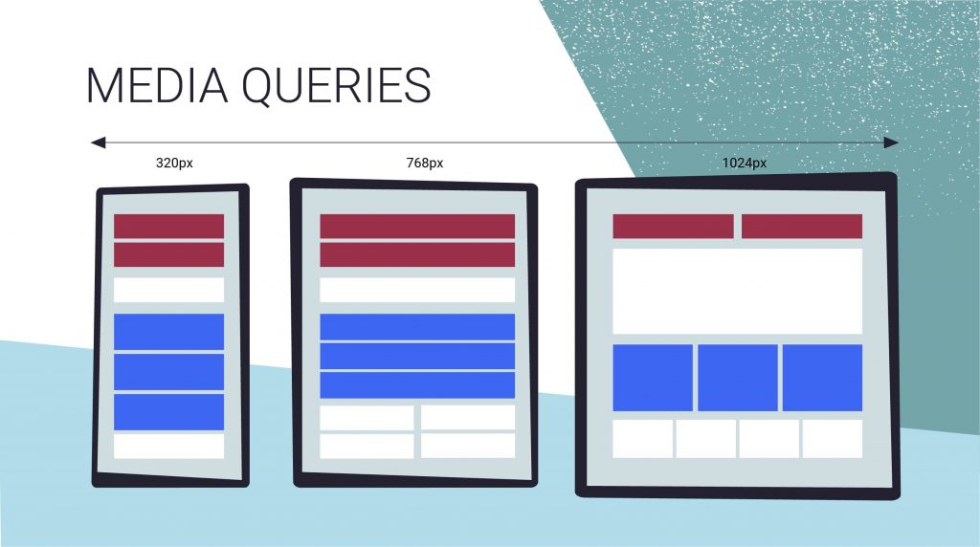
Flexible visuals
Of course, your website design consists not solely of textual content but also of visuals. And to make the website adaptation to the screen size complete, the visuals also must be fluid. For this reason, certain constraints have to be applied to the image. And other visual content to make it aware of its flexible environment. This is needed to prevent visuals from exceeding their container and to resize them proportionally. In this case, the responsive design applies scaling and CSS overflow to make images adjust and load appropriately to the screen size.

Slide 7
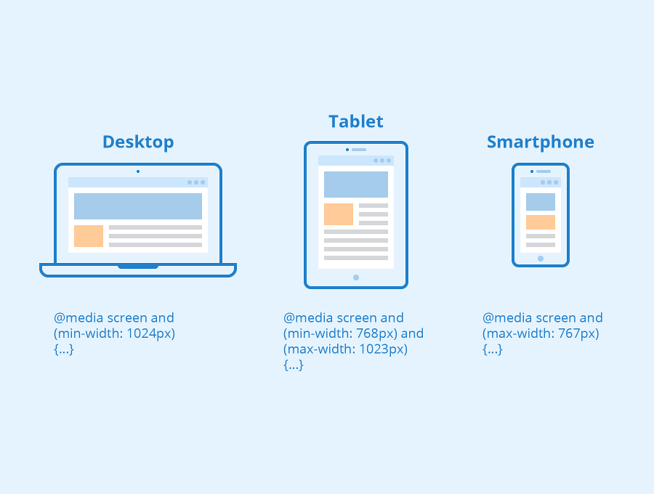
Media queries
A media query allows the website to determine the user’s device and to fit the page proportionally to the screen. Moreover, the media queries are able not only to detect certain device types but also to actually target the physical characteristics of the device. The query essentially consists of two elements: a media type and the actual query enclosed within parentheses with the specific media feature. In this way, the website design can assure a better and smoother user experience based on the specifics of their devices.

Slide 8
In this project, we will see how to create a multi-page responsive website that gives true results when interacted with. To create the website we need to have some skills. These skills include HTML, CSS, PHP, Bootstrap, etc. These programming languages will help you create a good web page. By creating web pages separately, we will need to connect every page through linking. The linking tag which is used is in HTML i.e. <href>.

Slide 9
Project Implementation:
First, we need to create a framework on how the webpage will look. The first page which is also known as the home page is quite important and the other subsequent pages are connected to its different links.
Then we will create the different web pages that will connect to the home page. We can also create many other pages that will connect to that subsequent webpage.
To make the website more responsive, we can do the linking through different images, buttons, etc. These can increase the approachability of the website.
The website should look attractive to get a click from the users, once you will learn all the necessary parts of web development in this course. You will be able to make good websites.
The languages HTML, CSS, and Javascript are used to create, decorate, and make it more dynamic respectively. Using all these three basics parts we can create good web pages.

Slide 10
TABLE OF CONTENTS:
HOME
ABOUT
PLACE
OFFERS
CONTACT

Slide 11
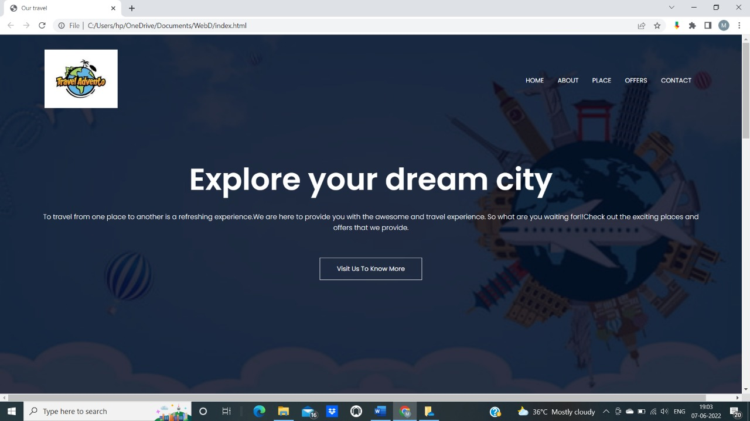
HOME:

Slide 12
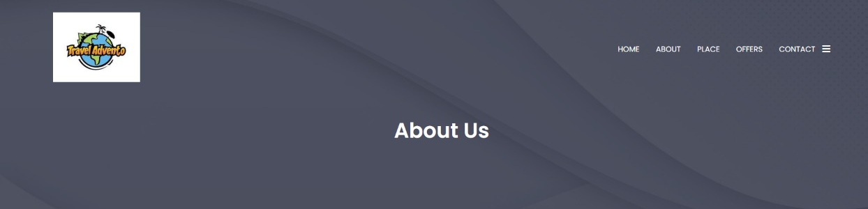
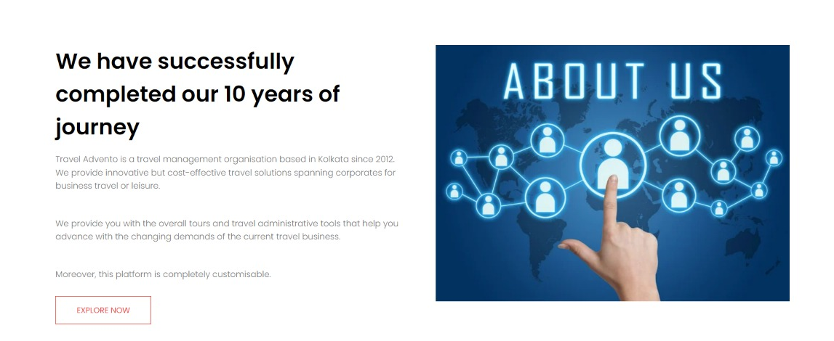
ABOUT:

Slide 13
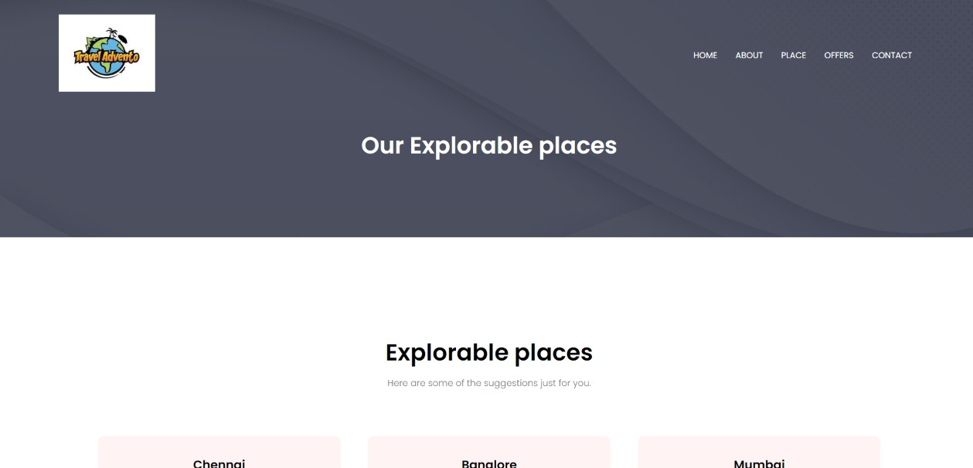
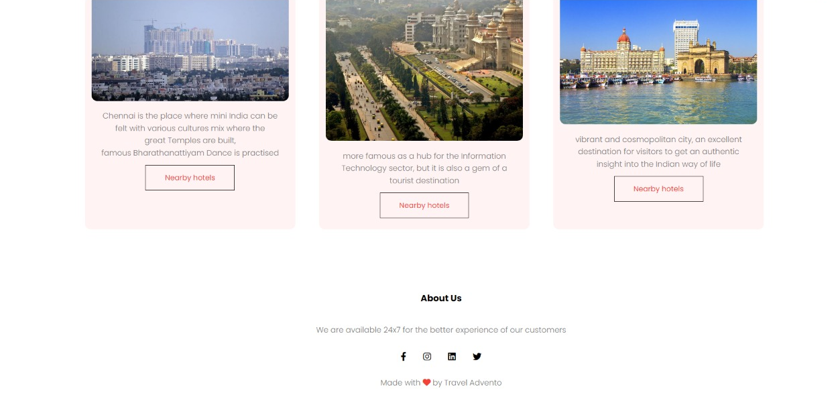
PLACE :

Slide 14
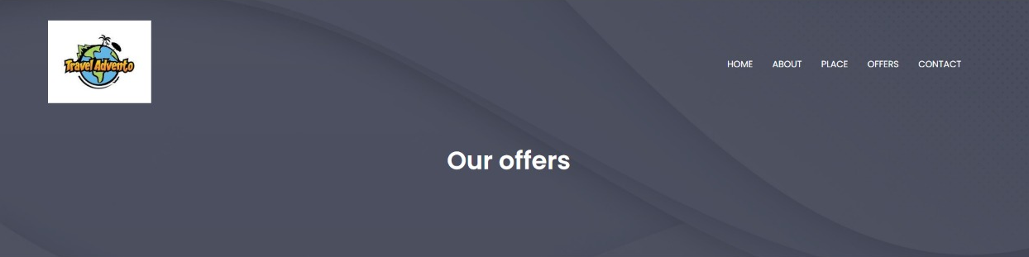
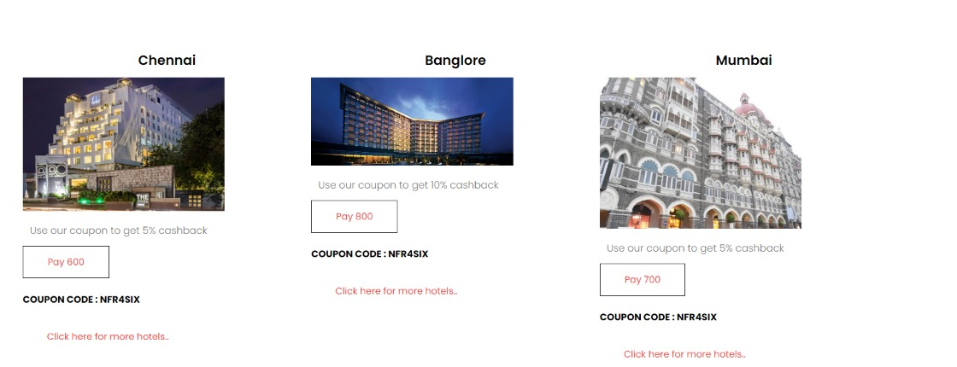
OFFERS:

Slide 15
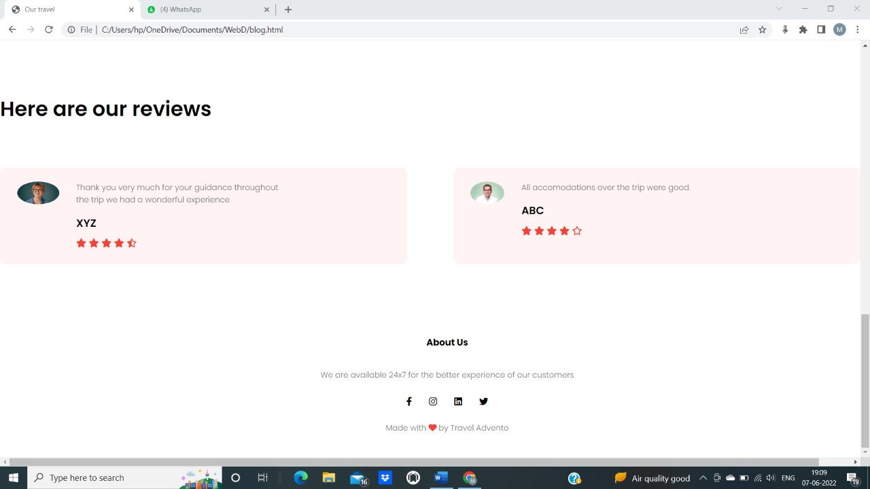
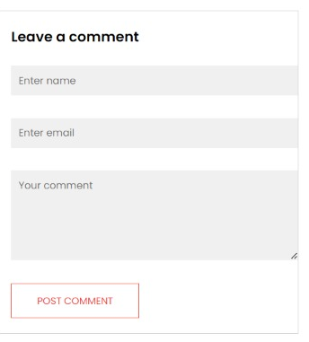

Slide 16
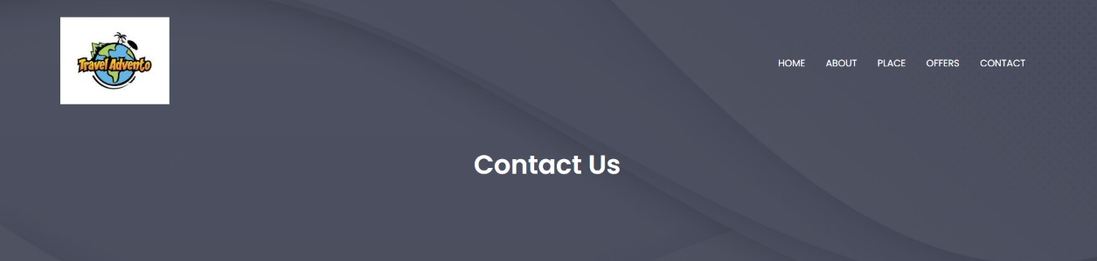
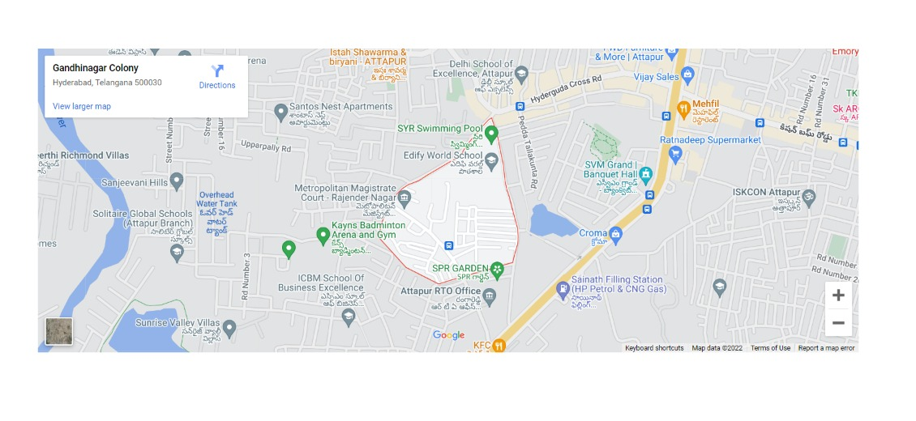
CONTACT:

Slide 17
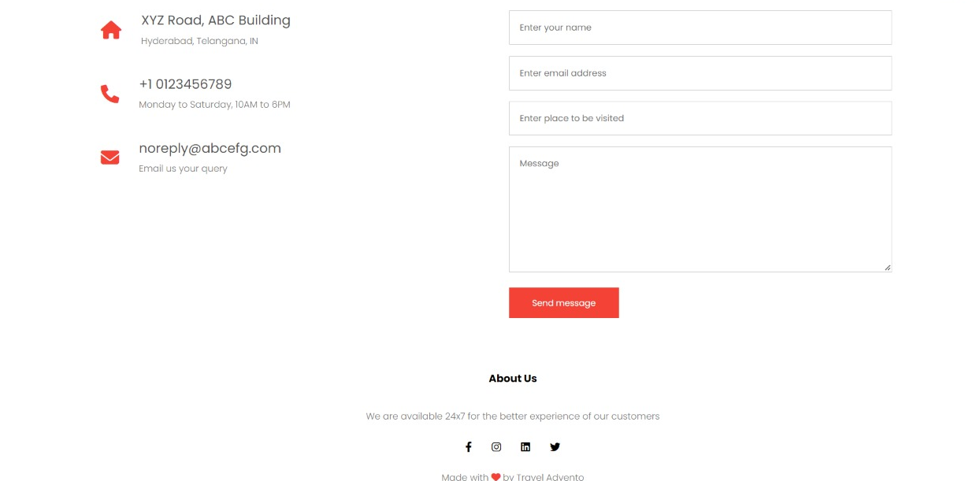

Slide 18


